Slide 1

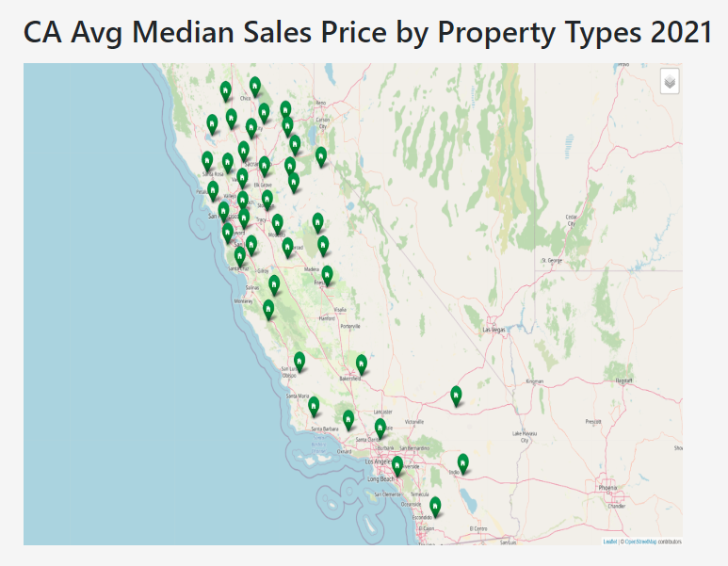
Housing Market over the past 10 yrs

